Slide 1

Proportion in Real Life
Where Math Meets the Real World!

Slide 2
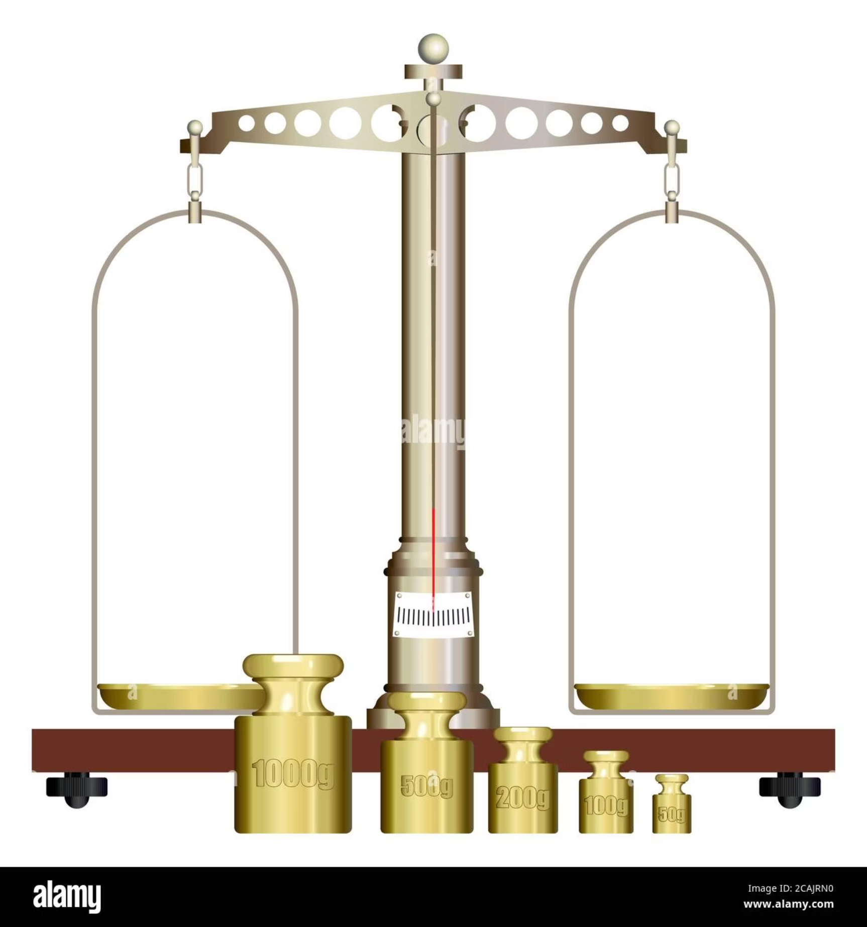
What is Proportion?
Proportion is simply the equality between two ratios. Think of it as keeping things balanced, whether you're making something bigger or smaller. It's all about maintaining the same relative size or relationship between different parts.
The key formula looks like this:
a : b = c : d
This means that the relationship between 'a' and 'b' is exactly the same as the relationship between 'c' and 'd'.

Slide 3
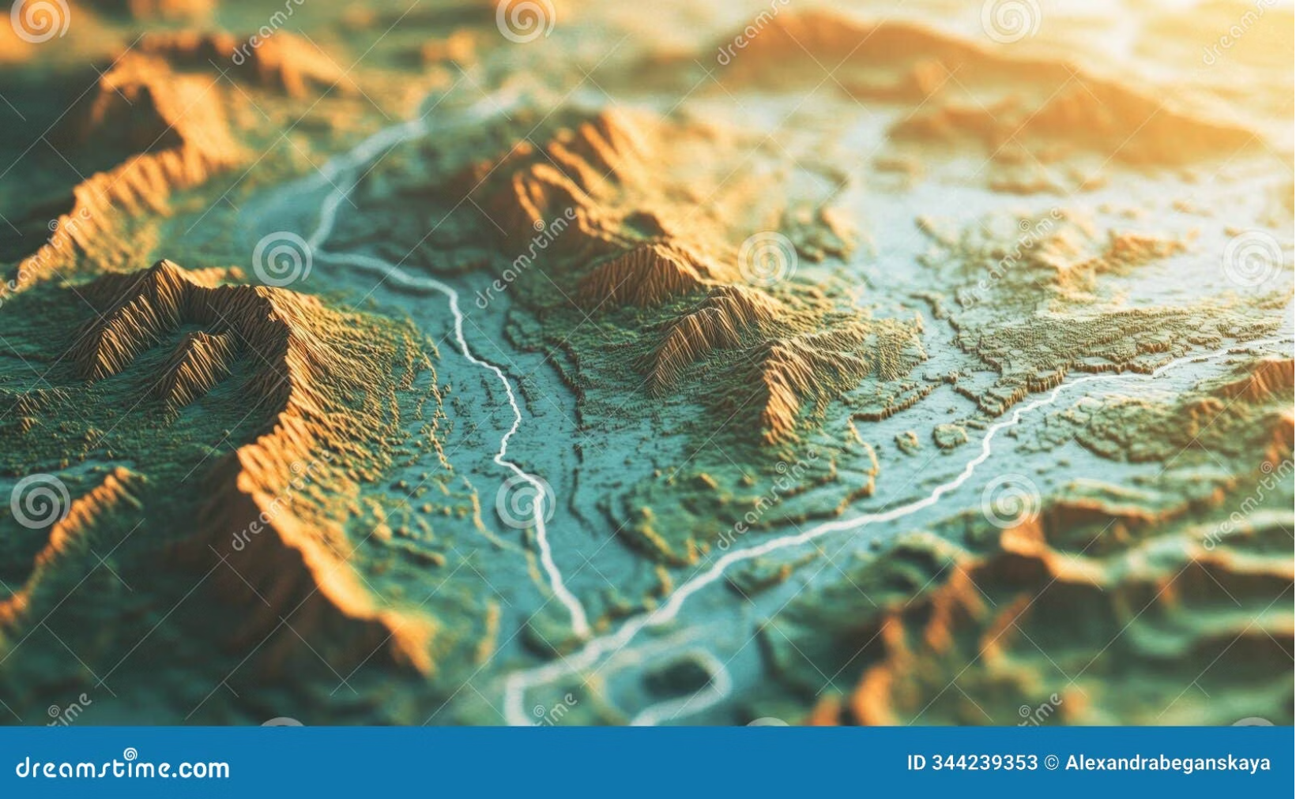

📍 Example 1: Map Reading
Have you ever looked at a map? Maps use scale ratios to represent real distances. Without proportion, maps would be useless! The scale tells you how much the real world has been shrunk down to fit on the map.
Let's try an example:
If 1 cm on a map equals 1 km in reality, how far is 4 cm on that map?
Answer: 4 km
Because if 1 cm = 1 km, then 4 cm = 4 x 1 km.

Slide 4
🗺️ Deeper Dive into Map Scales
Map scales are crucial for everything from planning a road trip to constructing buildings. They help us understand vast distances in a compact format. There are different ways to show scale:
Ratio Scale
Verbal Scale
Graphic Scale Bar
Expressed as 1:1000. This means 1 unit on the map equals 1000 units in the real world (e.g., 1 cm = 1000 cm or 1 inch = 1000 inches).
Written out, like "1 centimeter to 1 kilometer." Easier to understand at a glance for everyday use.
A visual ruler on the map that you can use with an actual ruler to measure distances. This is useful when resizing maps.

Slide 5
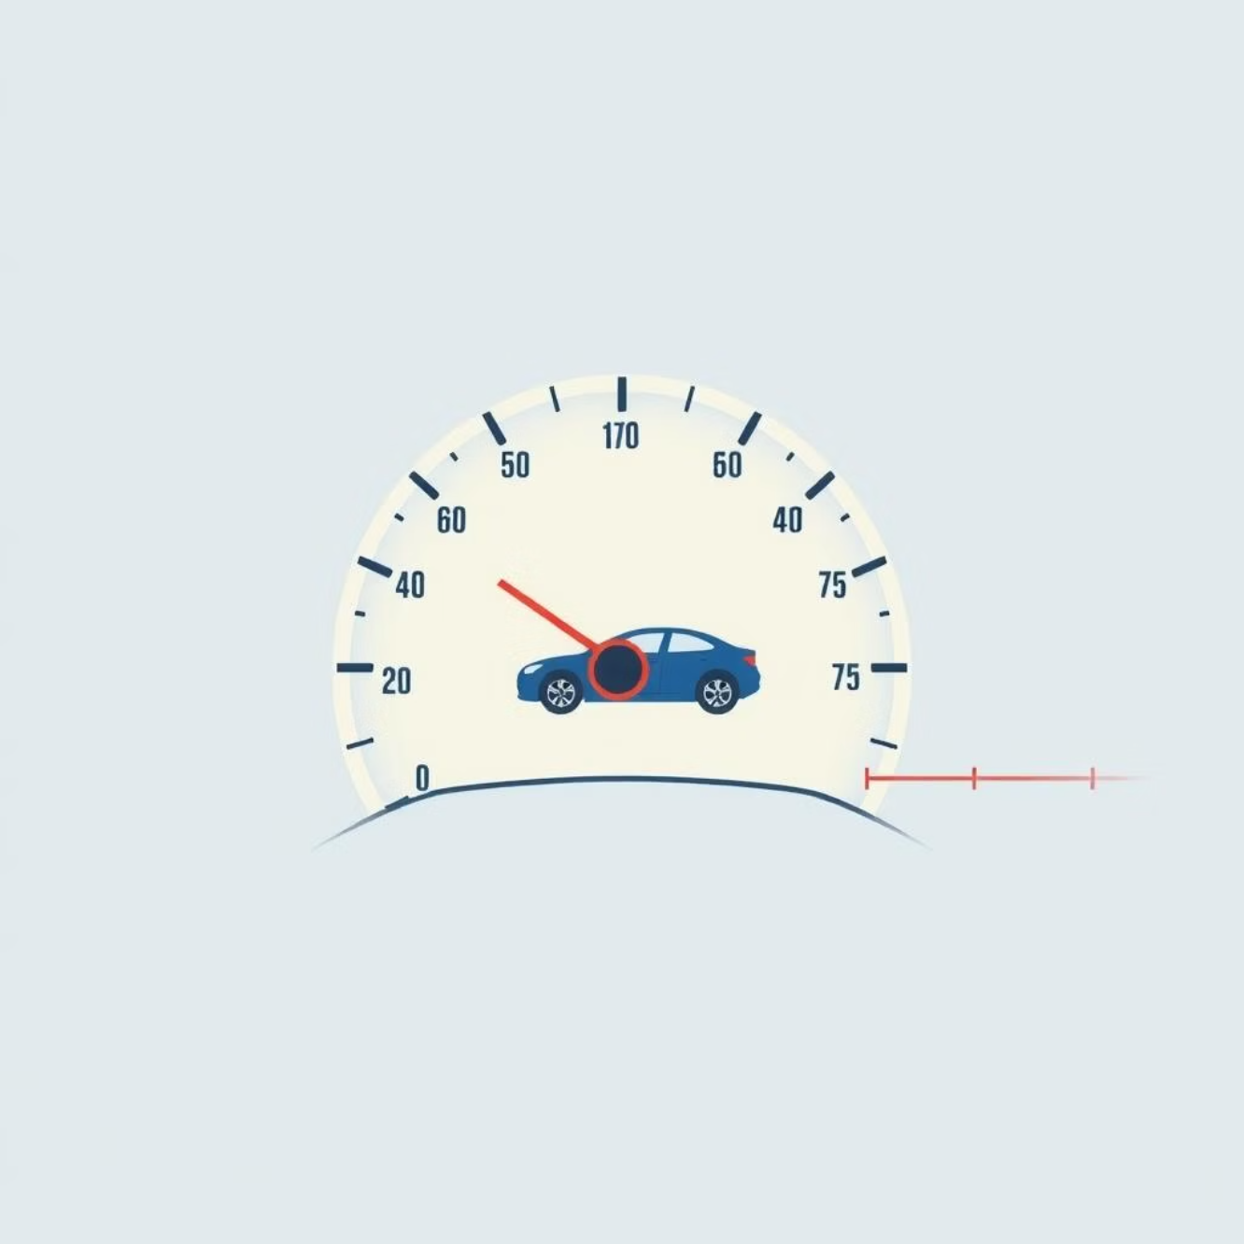

🚗 Example 2: Speed & Distance
Proportion helps us understand how speed, distance, and time are connected. If you know two of these, you can always find the third using ratios!
Speed = Distance / Time
Calculating Travel Time:
If a car travels 60 km in 1 hour, how far will it travel in 3 hours at the same speed?
We see a ×3 relationship for time (1 hour to 3 hours). So, we apply the same proportion to distance:
Answer: 180 km
60 km × 3 = 180 km

Slide 6



⏱️ More on Speed, Distance, and Time
This relationship is fundamental in many fields, not just driving. Pilots, athletes, and even delivery drivers use these calculations constantly.
Constant Speed
Calculating Time
Calculating Speed
If speed is constant, distance and time are directly proportional. Double the time, double the distance.
If you know distance and speed, you can find the time it will take (Time = Distance / Speed).
If you know distance and time, you can find the average speed (Speed = Distance / Time).

Slide 7


🏗️ Example 3: Scaling Models
Architects, engineers, and designers use proportion all the time to create miniature models before building the real thing. This helps them visualize designs, test ideas, and make sure everything fits together.
Building a Model:
A 1:50 model of a building means that every 1 cm on the model equals 50 cm in real height.
So, if a real building is 200 cm tall, how tall would its model be?
Calculation: 200 cm / 50 = 4 cm on the model.

Slide 8
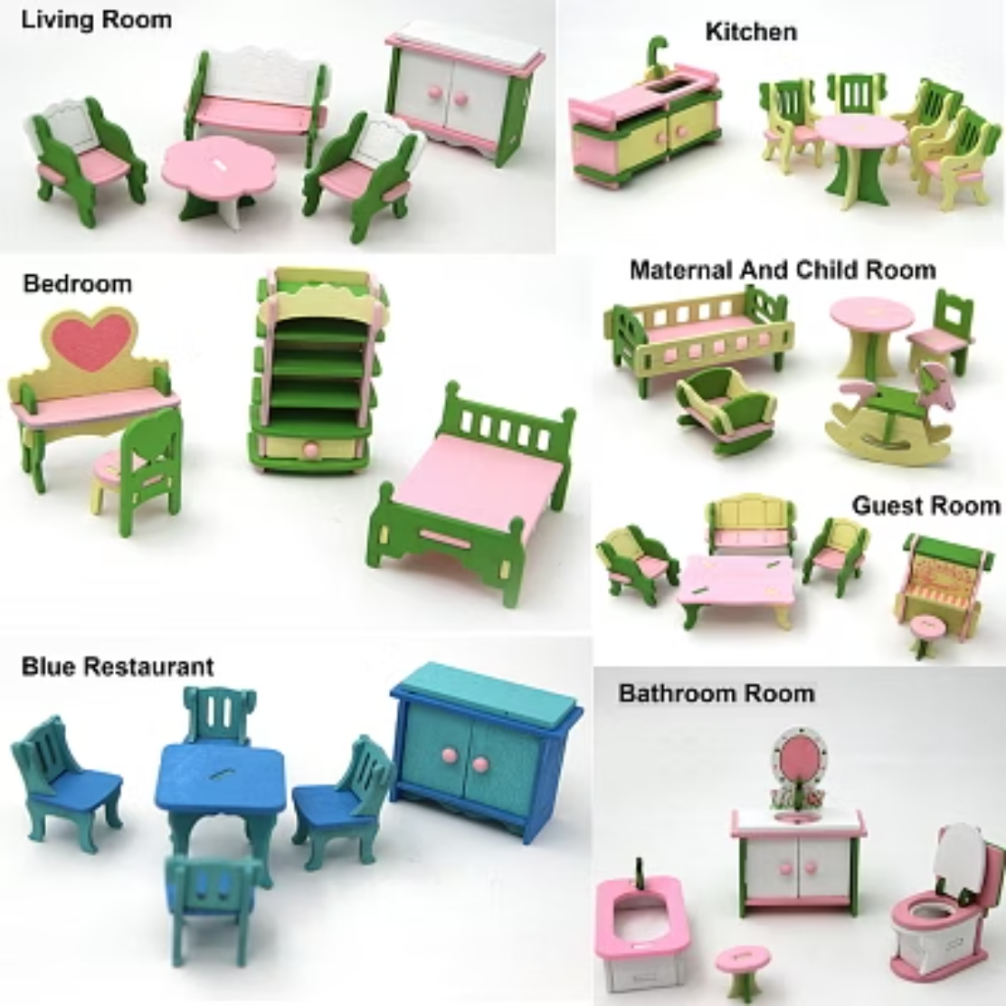


🏠 The Art of Miniature
Scaling models isn't just for buildings. Think about action figures, model trains, or even movie props! Proportion ensures that these smaller versions accurately represent their real-life counterparts.
Without strict adherence to proportion, these models would look distorted or unrealistic.

Slide 9




Interactive Summary: Proportion in Action!
Proportion is everywhere, linking math to our daily lives:
Navigation
Travel
Design
Using map scales to find distances and plan routes.
Calculating how far you can go or how long it will take.
Creating accurate models and plans for buildings and products.
Pop Quiz! 🧑‍🍳
A recipe for 2 people needs 100g of flour. How much flour do you need for 5 people?
Answer: 250g flour
Here's how: 100g / 2 people = 50g per person. So, 50g * 5 people = 250g!

Slide 10
Key Takeaways & Next Steps
Proportion is the relationship between two ratios, crucial for scaling and balance.
It's applied in everyday situations like map reading, calculating speed, and designing models.
Understanding proportion helps you solve real-world problems and think critically.
Want to explore more? Look for examples of proportion in your daily life:
How do photographers use proportion for good composition?
Where do artists use proportion in their drawings or sculptures?
Can you find proportion in music or dance?
Keep observing, keep questioning, and keep learning!

